Slide 1
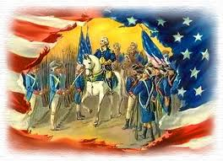
American Revolution (1775 – 1783)

Slide 2
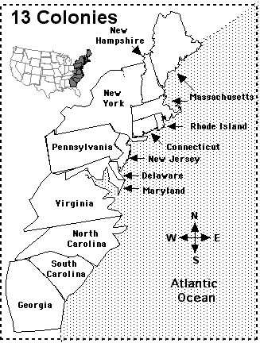

Slide 3
13 Colonies (pg. 91)
By 1775, the 13 Colonies had 2,500,000 people
Three Areas:
New England (settlers from England & Scotland)
Economy based on wheat farming & trade with Caribbean
Boston was the big city
Middle Colonies (Dutch, Swedes, English, Germans, Scots, Irish and many other settlers)
Breadbasket (farmers)
New York and Philadelphia were the big cities
Southern Colonies (settlers from England France, Germany)
Tobacco, sugar, rice and farms plantations.
Used slaves from Africa
Charleston and Baltimore were the big cities

Slide 4
Government (pg. 92)
Representative Government – Citizens elect people who represent them in government
All free adult male citizens in the 13 Colonies could get involved in the decision making process, but the British still controlled the laws of the colony
The local people could pass laws as long as they didn’t go against the wishes of the King of England.
If the King or British Government didn’t like a decision, they could veto (cancel) it

Slide 5
Protest
The Seven Year War was expensive for the British, so they raised taxes in the 13 Colonies to pay for the war
The British also kept an army in the 13 Colonies to keep order. More taxes were needed to pay for the army
The 13 Colonies citizens protested the taxes

Slide 6
Taxation Without Representation
Being taxed without having citizens elected to speak for you in government
The citizens of the 13 Colonies wanted the right to make decisions if they had to pay taxes
Many citizens felt the taxes were a waste of money, as France was no longer a threat in North America

Slide 7
Too Many Taxes!!! (pg. 95)
The British put many taxes on the 13 Colonies citizens. People hated these taxes!
Sugar Act (1764) – “sugar”
Stamp Act (1765) – “stamps and legal documents”
Townshend Act (1767) – “glass, tea, silk, paper, paint, lead”
Tea Act (1773) – “East Indian Company (British) was given a monopoly on all tea”
Boston Tea Party – 50 people dumped 3 ships of British tea into the sea as a protest to the tea taxes
Intolerable Acts (1774) – “Boston was closed to shipping until the tea was paid for. Soldiers sent in. Citizens not allowed to meet in groups.
Quebec Act was considered an intolerable act. Why???

Slide 8
Discuss with a partner:
What rules at Maple Leaf would you like to change?
Make a list of your top 3 rules

Slide 9
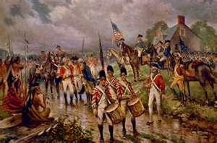
American Revolution
1775, protests turned into a violent armed conflict known as the American Revolution
The 13 Colonies fought against the British for their freedom
The United States of America was created after the colonists defeated the British in 1783

Slide 10
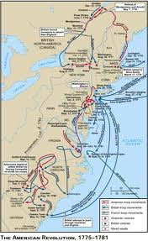

Slide 11
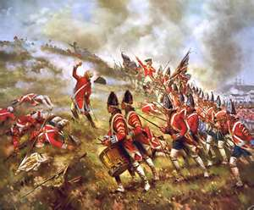

Slide 12
Canada during the American Revolution
The people of Quebec and Nova Scotia did NOT turn violent in their protests, and chose to stay apart of the British Empire
The Americans tried to get the people of Quebec and Nova Scotia to join in the revolution with the 13 Colonies

Slide 13
American Invasion of Quebec (New Years Eve 1775)
The American revolutionaries decided to do a two-pronged attack into the colony of Quebec.
First, they attacked Montreal, and easily captured it.
They then attacked Quebec, with was a fort city. By the time the Americans got to Quebec, it was winter and their army was in bad shape from starvation (no food). They attacked but could not take the fort.
200 American soldiers died, including General Montgomery
British only lost 6 soldiers
The British Navy arrived in May 1776, and the Americans went home.

Slide 14
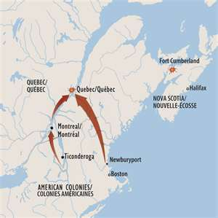
2-Pronged Attack

Slide 15
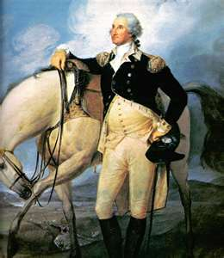
George Washington, the leader of the American revolutionaries (and the future first President of the United States of America) urged Quebecers to join the revolution. He stated that he had sent soldiers to Quebec to protect the Canadiens, not to hurt them.

Slide 16
Nova Scotia
Many of the people in Nova Scotia were Americans
The people in Nova Scotia remained neutral (didn’t pick sides) during the American Revolution
Nova Scotian’s were called “Neutral Yankees”

