Slide 1
British Columbia & Prince Edward Island Join Canada
BC joined Canada in 1871
PEI joined Canada in 1873

Slide 2
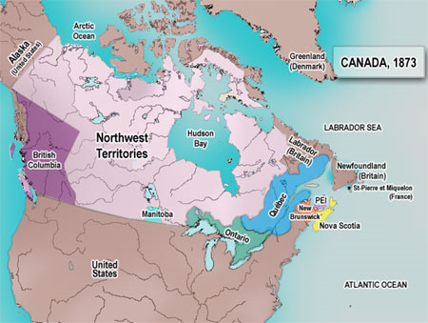

Slide 3
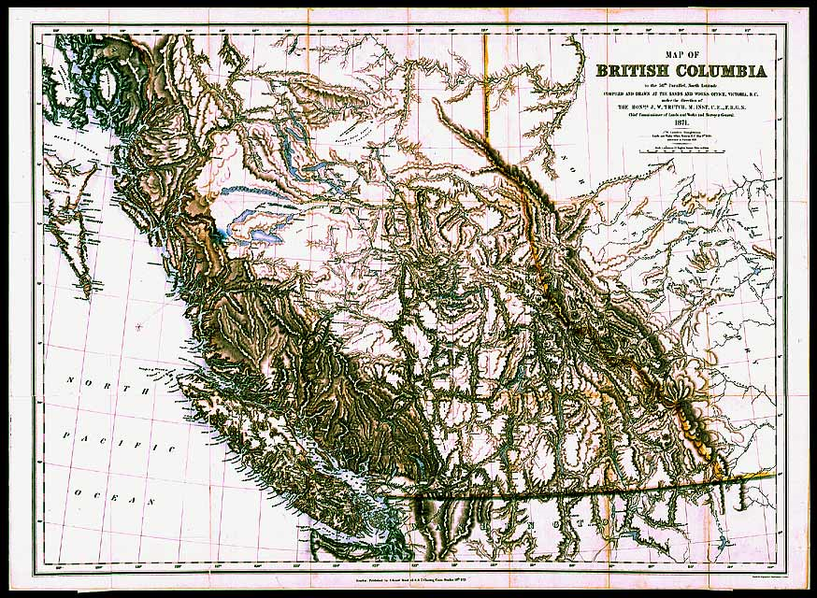
British Columbia
Enters Confederation

Slide 4
Prior to Confederation:
British Columbia was the only Crown Colony west of the Dominion of Canada in 1867
Crown Colony – means a colony under direct control of Great Britain
After explorers such as Cook, Vancouver, Mackenzie, Thompson and Fraser explored the area, the British took possession of British Columbia
The HBC and NWC were involved in the fur trade with the First Nations in the area

Slide 5
Vancouver Island
1849 – Vancouver Island becomes a British colony (before British Columbia mainland)
1851 – James Douglas of the HBC becomes the Governor, and makes Fort Victoria the HBC headquarters
In 1851, there were only 1,000 settlers living on Vancouver Island, but there was a large First Nations population

Slide 6
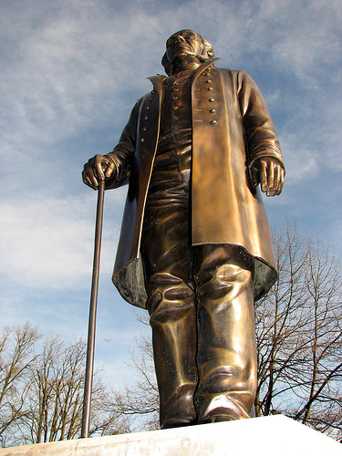
Sir James Douglas
Came to Canada from Scotland in 1819 to work for the NWC
Moved west with the HBC in 1821 and founded Fort Victoria as the HBC headquarters
Became the second governor of the colony of Vancouver Island
Known as the Father of British Columbia
He was granted a knighthood by the British monarchy for keeping law and order in British Columbia during the gold rush. He became “Sir” Douglas

Slide 7
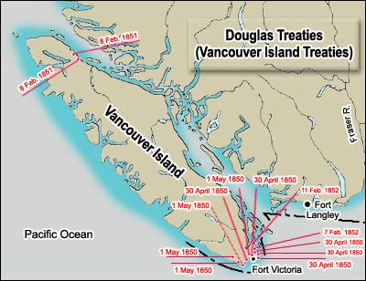

Slide 8
Mainland British Columbia
British Columbia was known as New Caledonia
1858 – Gold rush hits the Lower Fraser (Thompson River) and 30,000 miners flood into the area. Many miners are from the United States
1858 – Governor Douglas convinces the British to make New Caledonia into a British colony and it is re-named British Columbia
Gov. Douglas was worried about lawlessness in the area because of the miners, just like what happened in California in 1849

Slide 9
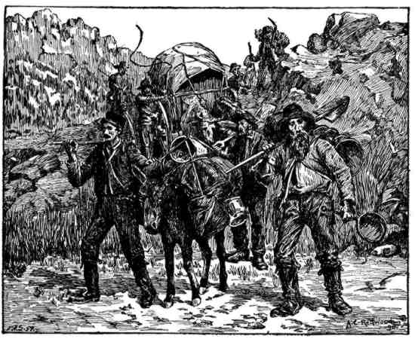
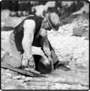
GOLD RUSH

Slide 10
In 1862 – A second Gold Rush hits the Cariboo region of BC and many more miners come search for gold
By 1865, the gold rush was coming to an end and the colony of British Columbia and the colony of Vancouver Island were in financial trouble
In 1866, the British unite British Columbia and Vancouver Island into one colony
New Westminster was the original capital city, but it was moved to Victoria in 1868, where it has been ever since

Slide 11
Mr. Austen was born in Victoria!

Slide 12
By 1868, the colony of British Columbia was heavily in debt because of gold rush construction, such as roads
When the gold rush ended, there was no money left to pay for the construction
Coal mining, farming and lumbering became the main industries in British Columbia
Some people wanted to join the United States, but most people favoured joining Canada in order to keep its strong ties with Great Britain

Slide 13
British Columbia Act (1871)
Delegates from BC went to Ottawa to discuss becoming a province of Canada in 1870
In return for BC joining into Confederation, Canada promised:
A railway joining BC to the rest of Canada would start within 2 years and completed in 10 years
Canada would pay off BC’s debt of $1,000,000
Yearly grant of $35,000, plus a yearly grant of 80 cents per person until BC had a population of 400,000 people
BC would have control of government-owned public lands (Crown Lands), just like the other provinces.
British Columbia became Canada’s sixth province in 1871

Slide 14
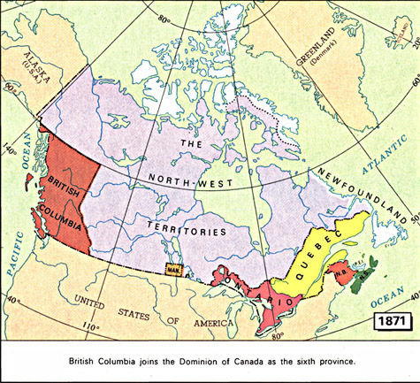

Slide 15
Newfoundland
Did not trade much with Canada
Exported fish to Europe, West Indies and Brazil
Imported trade goods from the United States
Was strongly against joining Confederation in 1867 because they did not want to pay taxes or have their trading partners restricted
They already had been granted responsible government from the British since 1855
By 1894, the price of fish dropped and Newfoundland was in debt.
Delegates from Newfoundland went to Ottawa to negotiate terms of joining Canada, but the terms could not be agreed upon
Newfoundland did not join Canada until 1949

Slide 16
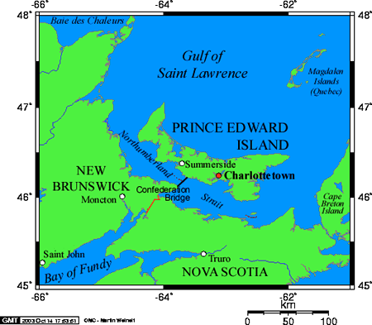
Prince Edward Island joins Confederation

Slide 17
Prior to Confederation
PEI rejected joining Confederation in 1867, even though it hosted the Charlottetown Conference in 1864
In the 1860’s, PEI shipyards were producing over 100 ships per year and its farms exported good harvests to Europe
People thought there were not financial benefits for joining Canada at that time
But many PEI landlords did not own their land. Absentee landlords owned a lot of the farmland from Britain
If they joined Confederation, they would have only 5/200 seats in the House of Commons (rep by pop)

Slide 18
Why did PEI change their minds?
Absentee Landlords – Farmers wanted to own land
PEI was deeply in debt because of the declining economy
Wooden ships built in PEI were no longer needed around the world, as steam engine and iron hull ships took their place
The biggest reason for PEI’s debt was the building of the island railway
Costs estimated at $4000 per km went to $14,000 per km
By 1873, railway construction stopped because of the debt and PEI decided to look into joining Confederation to get out of debt

Slide 19
Prince Edward Island Act (1873)
July 1st, 1873, Prince Edward Island joined Canadian Confederation as the seventh province
Confederation was not really a celebration in PEI because it was needed to get PEI out of debt
The Canadian government agreed to:
Give PEI a $800,000 loan, which would be used to buy back land from absentee landlords
Canada would pay all PEI railway debt
Provide a $50 grant for every person living on the island
Ferry and telegraph service would be provided to the island

Slide 20
Chapter 10 Quiz Next Class!!

