Slide 1
Chapter 8
Lord Durham:
- Governor General of British North America for 5 months in 1838.
He was sent to BNA by the British to investigate the
Causes of the 1837 rebellions in Upper and Lower Canada.
Interested in educating the poor and giving
people more control over government.
Named “Radical Jack” in the British House
of Commons
Wrote the Durham Report when he returned
to England, and died in 1840.

Slide 2
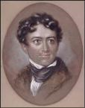
Durham Report
The two colonies of Upper and Lower Canada should become one colony called the United Province of Canada.
The new united colony of Canada should have responsible government, which means the government is responsible to the people.
* Example: The executive council would be chosen by the Legislative Assembly, which is elected by the people.
(The people of Canada would have the power!)
http://www.histori.ca/minutes/minute.do?id=10141

Slide 3
The Act of Union (1841)
The British government decided to follow one of Lord Durham’s recommendations.
The Act of Union joined Upper and Lower Canada together as the United Province of Canada.
This was the first step towards Confederation “Canada becoming a real country”
Aim: British were hoping the English speaking members from Upper and Lower Canada would unite and control the Legislative Assembly.

Slide 4
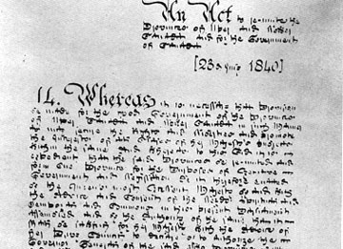
Act of Union (1841)
Rules:
Created a single government
Equal representation from Canada West and Canada East
English would be the official language of government

Slide 5
Lord Elgin
Became the new Governor General in 1847
His instructions were to permit responsible government

Slide 6
Rebellion Losses Bill (1849)
The bill (proposed law) presented to the Legislative Assembly wanted to pay the people of Canada East for property damage from the 1837 Rebellion in Lower Canada.
The people of Canada West already were repaid for their property damage
The Tories didn’t like this bill because they didn’t want rebels to get any money for losing the rebellion
There were riots in Toronto, Kingston and Montreal
An angry mob set the Montreal Parliament (government) buildings on fire in protest and threw eggs, rocks, vegetables and dead rats at Lord Elgin
This was the first test to responsible government!

Slide 7
LOOK AT THE PICTURE OF THE GOVERNMENT OF THE UNITED PROVINCE OF CANADA ON PAGE 166

Slide 8
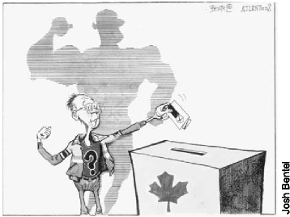
Political Parties
Definition: A group of people with similar beliefs about government, who work together to get their candidates elected as representatives.
The party with the most elected members controlled the Legislative Assembly, so members united in political parties in order to get power.

Slide 9
Life in the Province of Canada
Canada West
Canada East
In 1841, the two largest cities in Canada West were Toronto (15,000) and Kingston (3000).
Kingston was the capital of Canada from 1841 to 1844.
Wheat was the major crop.
In 1841, the two largest cities in Canada East were Quebec City (31,700) and Montreal (40,000).
Montreal was the capital of Canada from 1844 to 1849.
Most people were habitants and still farmed using the Seigneurial system.

Slide 10
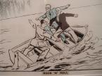
Transportation
Life was made easier by the construction of canals.
Lachine Canal (1825)
Welland Canal (1830)
Rideau Canal (1832)
The first railway was constructed in 1836 near Montreal.
1840’s: 100km track built
1850’s: 3200km track built
Railways were cheaper than canals

Slide 11
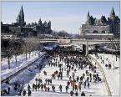
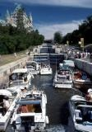
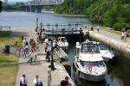
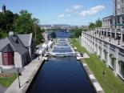
Rideau Canal

Slide 12
HOMEWORK: STUDY FOR THE CHAPTER 8 QUIZ!

