Slide 1
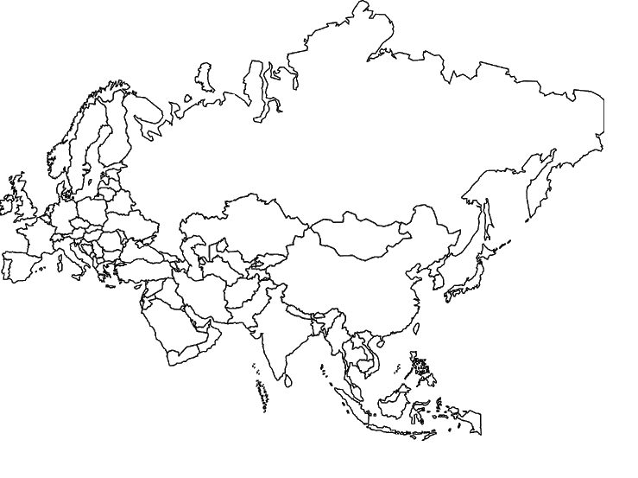
Eurasia=Europe and Asia

Slide 2
Allies push into Germany from the west, 1945.

Slide 3
Soviets push in to Germany from the East.

Slide 4
When the two meet, the cold war begins!

Slide 5
Germany is split in two. The Berlin wall becomes a symbol of the Cold War.
Churchill: An Iron Curtain has descended upon Europe.
Mostly Capitalist
Multi-party system
Democratic
Communist
One-party system
Dictatorship

Slide 6
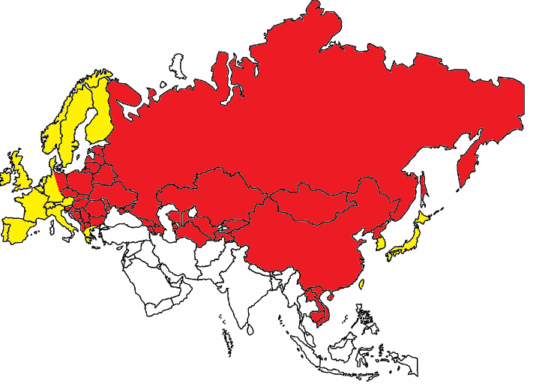
The Cold War becomes a global conflict: 1945-early 1990s

